Slide 1
Introduction to Make
Prof. Darrell Long
CSE 13S

Slide 2
What’s the make program?
A utility on most Unix systems that automatically builds executable programs and libraries from source code
Has several derivatives, one of which is GNU Make (gmake), the standard Make implementation on Linux/OSX (also on the UCSC Unix Timeshare)
Has a variety of command line flags/options to select from
Requires a Makefile

Slide 3
Need a slide discussing the idea of dependencies
These dependencies form a directed graph
You first do the thing that has NO dependencies
That removes that from the things that depend on it
Now you can do those things
This is called topological ordering

Slide 4
Some useful make flags/options
-C [dir], --directory=[dir]
Changes to directory [dir] before looking/running any Makefiles
-d
Print debug information in addition to any normal processing information
-f [file], --file=[file], --makefile=[file]
Specifies [file] to be read as the Makefile
-I [dir], --include-dir=[dir]
Specifies [dir] to be a directory to search in for Makefiles
--warn-undefined-variables
Warns about referencing of undefined variables

Slide 5
What’s a Makefile?
Plaintext file that contains instructions for the make program
Typically resides in the same directory as source code and is named “Makefile”
Composed of rules
”A makefile is just a directed acyclic graph” – Darrell Long, 2018

Slide 6
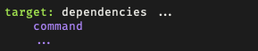
What’s a rule?
Associated with/composed of the following:
A target
A set of dependencies
A set of commands
General structure of a rule:

Slide 7
What’s a target?
Basically the name of a rule
Users specify which target to make by running “make [target]”
Usually the name of the file that is generated by executing the rule’s commands, but can also be a name of an action to perform (a phony target)
If a target isn’t specified on the command line, make defaults to making the first rule
Users can designate a default make target using .DEFAULT_GOAL := [target]

Slide 8
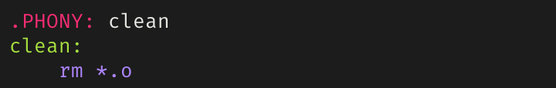
What’s a phony target?
An target that, when its rule is executed, doesn’t produce a file with the same name
Important since it prevents make from erroneously checking for files since real and phony targets are now differentiated
A phony target is marked as phony by simply having “.PHONY [target]” directly above itself
Example of a phony target:

Slide 9
Some conventional phony targets
clean:
Removes any files produced by running a make command
Be careful to only remove executables and object files, not source code
all:
Usually consists of a list of dependencies which includes all the rules defined in the Makefile
Usually placed as the first rule so running “make” defaults to executing it

Slide 10
What’s a dependency?
Either a target or a filename (this includes source and header files)
If a rule has a dependency that has been modified or if its target doesn’t exist, make tries to fill in the dependency by executing the rule with the dependency name
Else if the dependency hasn’t been modified or if its target already exists, make doesn’t execute the rule to make the dependency
The above two points illustrate how make tries to be efficient; don’t make something that is already up-to-date

Slide 11
What’s a command?
An action to be executed
Can generally use shell scripting commands (think bash commands)
A rule can have more than one command, each on its own line
Must have a tab character in front of entire command (GNU Make does now support custom recipe prefixes if you really don’t want to use a tab character…)

Slide 12
Variables in Makefiles
Four types of variable assignments in a Makefile
“=“ – lazy assignment
“:=“ – immediate assignment
“?=“ – conditional assignment
“+=“ – concatenation
To use the value of any variable, surround the variable in parentheses or curly brackets and prepend a dollar sign:
$([variable]) or ${[variable]}

Slide 13
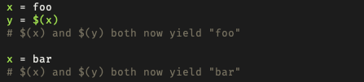
Lazy Assignment – “=“
Variables lazily assigned using the “=“ operator are called recursively-expanded variables
Contents of the variable assignment are stored as-is, variables as variables, references as references
make waits to expand the variable’s references until the variable is being used
Example:

Slide 14
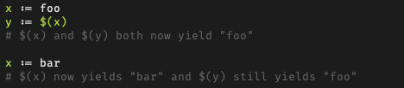
Immediate Assignment – “:=“
Variables immediately assigned with “:=“ operator are called simply-expanded variables and behave like variables in C
Variable assignment is evaluated and the result assigned to the variable
If variable assignment is a variable reference, the reference is expanded before the assignment
Example:

Slide 15
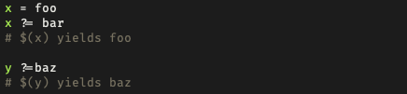
Conditional Assignment – “?=“
“?=“ behaves like “=“, except assignment occurs if and only if the variable hasn’t been assigned a value yet
Example:

Slide 16
Concatenation – “+=“
Behaves like “=“ if the variable in question hasn’t been defined
Essentially adds extra text to a defined variable separated by space
Example:
x := foo
x += bar
Is equivalent to:
x := foo
x := $(x) bar
Useful for adding debug flags like “-g” to defined compiler flags

Slide 17
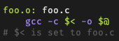
Automatic Variables
Make automatically defines some special variables within the context of an individual rule
Some useful automatic variables:
”$@”: the name of the target
“$^”: list of all dependencies for target
“$?”: list of dependencies more recent than the target
“$<“: the name of the first dependency

Slide 18
Commands, Compilers, and Compiler Flags
Variables are used to factor Makefiles to make them prettier and easier to maintain
Some standard Makefile variables used for compiling C programs:
CC – the C compiler to use (typically gcc or cc)
CFLAGS – a list of compiler flags (each flag is prefixed with a hypen “-”)
Some good flags to use when compiling C programs:
Wall, Wextra, Wpedantic, Werror, g
OBJECTS – a list of object files to build and link

Slide 19
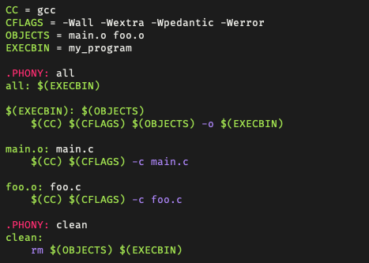
What we can do so far
But can we make this better?

Slide 20
The shell function
Communicates with the world outside of make
Performs command expansion: takes a shell command and evaluates to the output of the command
Newlines in command output are converted to spaces
A useful example of the shell function:
The above example can also be done using the wildcard function

Slide 21
What does := mean and how is it different from =?
I think I addressed this in slides 13 and 14 but if it needs to be more specific I can add another slide as a summary?

Slide 22
The wildcard function
Can be used in rules as the “*” operator, where its expanded by the shell
If used for a variable assignment, wildcard expansion doesn’t occur using “*” unless the wildcard function is explicitly specified
The previous example to get source files using wildcard:
A rule using a phony target to delete object files using wildcard:

Slide 23
The patsubst function
Is formatted as $(patsubt pattern,replacement,text)
Finds whitespace-separated words in [text] that match [pattern] and replaces them with [replacement]
An example of using patsubst to get a list of object files:
Note that the above example uses the pattern match placeholder operator “%” instead of the wildcard operator “*”

Slide 24
We need some slides on patterns

Slide 25
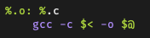
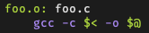
Pattern matching
Utilizes the pattern match placeholder ”%”
Example:
When “make foo” is typed, this rule pattern matches to:
Note that automatic variables are needed to designate the first dependency and target names

Slide 26
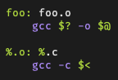
Pattern Matching (cont’d)
Great for scalability (easier to apply one rule for many many files)
Doesn’t match every filename
Only executes if there’s a dependency that needs to be created which matches the rule
Example:
Running “make foo” looks for “foo.o”, so the rule becomes foo.o: foo.c
Even if there are other C files in the directory, the pattern matching isn’t executed

Slide 27
“*” vs “%”
Difference is that “*” performs expansion and “%” serves as a pattern match placeholder
Consider the previous example where object filenames are generated by source filenames:
$(wildcard *.c) performs wildcard expansion to get all the source files
%.c makes % match all text leading up to “.c”
“.c” is then replaced by “.o” in all instances of a match from %.c
The previous example can also be written as:
OBJ = $(SRC:.c=.o)
This effectively replaces “.c” with “.o”, which is more intuitive, but patsubst is good to know

Slide 28
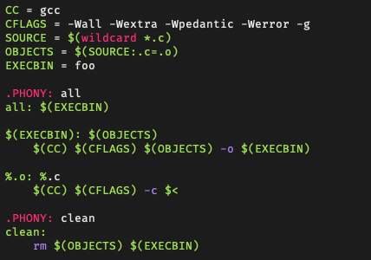
Putting it all together
Example of a generic Makefile that works for many simple programs:

